Slide 1

Predicting Laptop Prices
By Nataniel Moreau

Slide 2
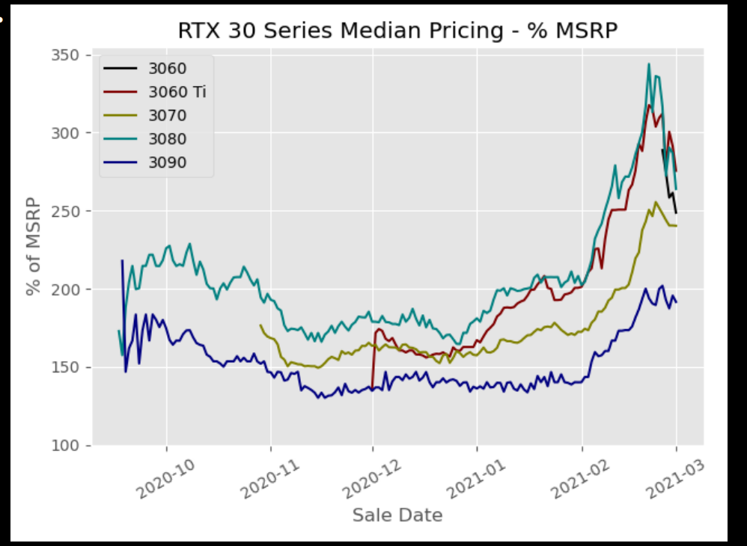
Why does it matter?
PC prices gone crazy since pandemic
Driven by scarcity of inputs?
Supply bottlenecks
Corporate greed
Scalpers
Can inputs still accurately predict sale price?
Nvidia 3rd vs 4th Gen GPUs

Slide 3
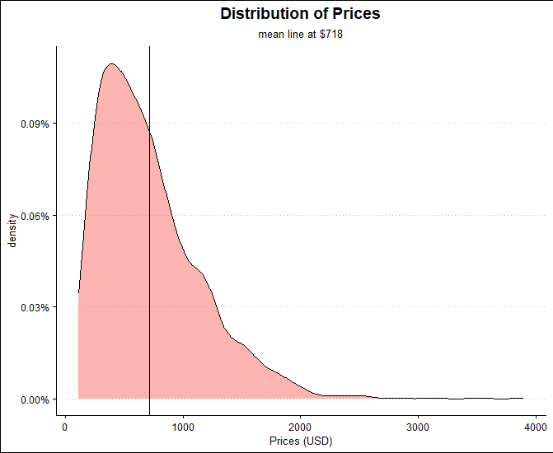
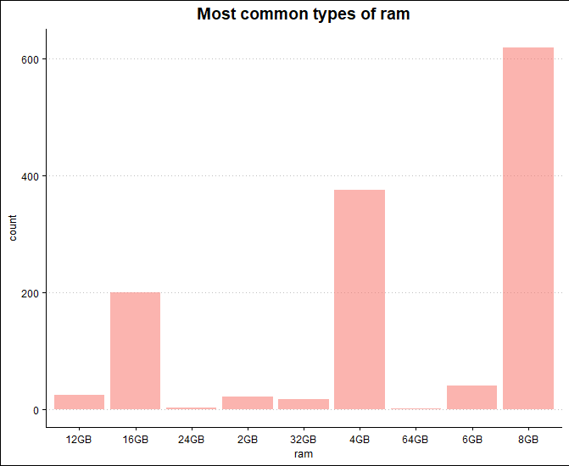
Data
Laptop prices by specs (ram, memory, gpu, cpu, screen size, etc. )
10 predictors in total
Sourced on Kaggle
Heavily skewed right
Largely gaming laptops and MacBooks
Challenges
Large amounts of unique instances
Not equal among types of laptops
Low-mid end

Slide 4
Methods of Analysis
Model 1: Basic Linear Estimator
Tuning:
Sequential Step-Wise Selection
Leap package
Nvmax:1-10
High # of predictors preferred
Best Model: 8
Model 2: Lasso
Tuning:
Tidymodels
Penalty:
Version 1: .1-1; 1 preferred
Version 2: .1-5; ~3 preferred
Models 2.5(rip) & 3:
Rand Forest
ElasticNet
Tuning:
Penalty:
.1-5; ~4 preferred
Mixture:
0-1; .8 preferred
Model 4: Boosted Trees
Tuning:
Xgboost
Trees, depth, learning rate
"Fast" Learner
.1 learning rate (max)
9 tree depth (10 max)
100 trees (max)

Slide 5
Results
Chosen Metric: rmse
Price analysis: magnitude matters
Anchoring
Mean: $718
Range: $111-$3899
P25-75: $383-$952
Expectations?
Volatility/randomness of market would lead to poor/mediocre performance.
1st ElasticNet:
CV Training rmse: $161
Test rmse: $141
2nd Lasso:
CV Training rmse: $162
Test rmse: $141
3rd Boosted Trees:
CV Training rmse: $224
Test rmse: $208
4th Sequential Step Wise:
CV Training rmse: $365
Test rmse: $317

Slide 6
Results: take ways
Variation within estimators hurt performance
PCs too customizable
Hard to predict onto new unique configurations
Less to say about market for laptops
Main fluctuations in GPU market
Main drivers RAM & Memory
Better Test Performance than training validation
Smaller dataset, less variation in the estimators?
Just luck of the draw?

Slide 7
Thank you!

